Slide 1
Tensorflow

Slide 2
Library yang digunakan (Tensorflow version 2.x)
__future__
H5py
Math
Numpy
Matplotlib
Random
cv2

Slide 3
Dataset? (KMNIST - Kuzushiji)
https://www.kaggle.com/anokas/kuzushiji
Historical Document, Japanese handwritten Kuzushiji. Awal mula dari dataset ini ada yaitu karena banyak penduduk asli jepang yang tidak dapat membaca huruf tersebut.
10 kelas, 60.000 training dataset, 10.000 test dataset
Class Map :
0 = お
1 = き
2 = す
3 = つ
4 = な
5 = は
6 = ま
7 = や
8 = れ
9 = を

Slide 4
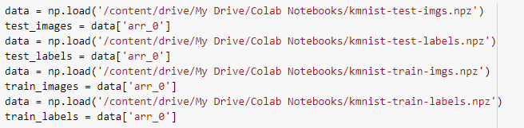
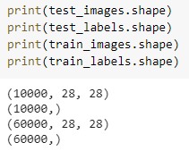
How we load dataset?
Download from kaggle the “.npz”
Using the load function from numpy library
Testing shape :

Slide 5
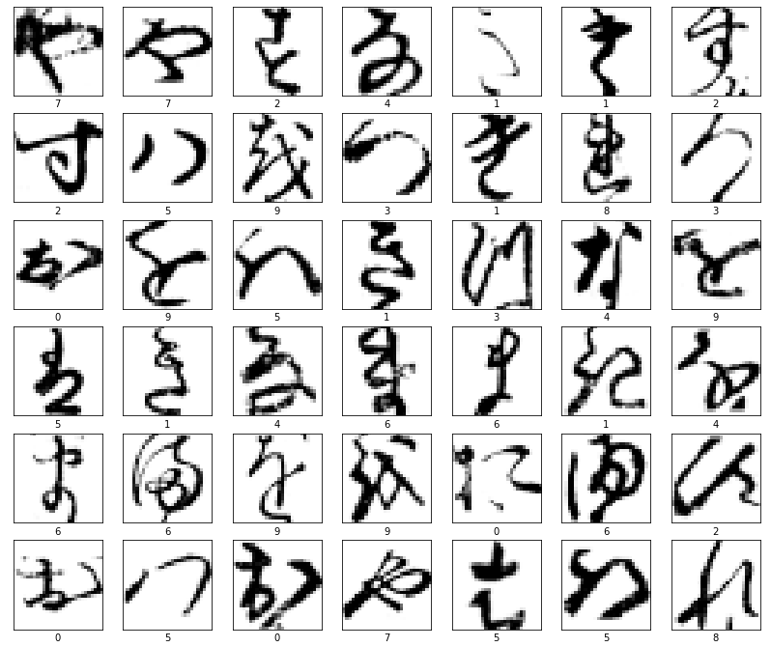
Appearance of the images
28x28

Slide 6
Deep Learning Model
Layer 1 : CNN, 6 Kernel, 3x3, act_f = relu, no_bias
Maxpooling : 2x2
Layer 2 : CNN, 6 Kernel, 3x3, act_f = relu, no_bias
Maxpooling : 2x2
Flatten
Layer 3 : Dense Layer, 64 kernel, act_f = relu
Layer output : Dense Layer, 10 kernel, act_f = relu

Slide 7
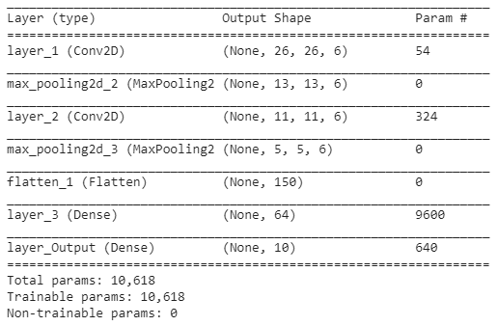
Summary

Slide 8
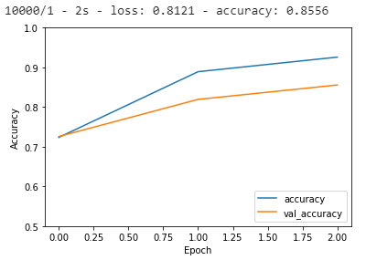
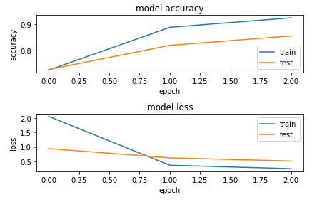
Compiler & Training
Optimizer = adam
Loss = Sparse Categorical Crossentropy
Ephocs = 3
Test Accuracy = 85,56%

Slide 9
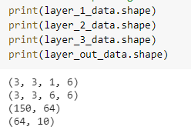
Weight Shape ?

Slide 10

Test Accuracy of Quantized Weight and Images

Slide 11
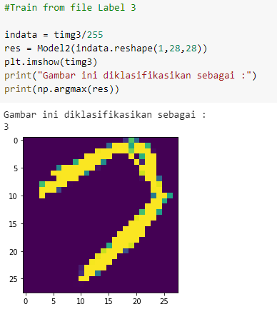
Testing with image from user

Slide 12
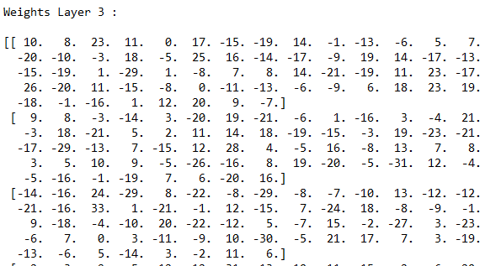
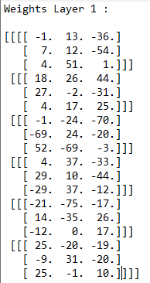
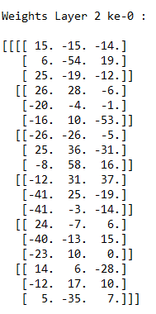
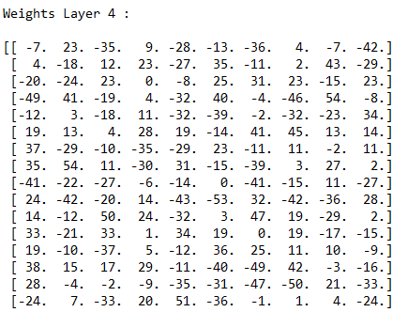
Weight Value
(array([0.09881388, 0.09752722, 0.09821551, 0.10697497, 0.10182809,
0.10083442, 0.10087133, 0.09974821, 0.09546809, 0.09971828]),)

Slide 13
#include <stdio.h>
#include <stdlib.h>
#include <math.h>
#include "weights.h"
#include "cnnfunction.h"
int main(void)
{
//Output Layer
float layer_1_out[6][13][13];
float layer_2_out[6][5][5];
float layer_3_out[64];
float layer_last_out[10];
float result;
//Konstanta pengali untuk output layer sebelum masuk kuantisasi untuk input testing gambar 3
float Scale_w1 =0.0032400540479524866;
float Scale_d1 =0.007874015748031496;
float Scale_w2 =0.004680760732785923;
float Scale_d2 =0.0034186397041388442;
float Scale_w3 =0.006520035698657899;
float Scale_d3 =0.0009874517863943284;
float Scale_w4 =0.005369161526987872;
float Scale_d4 =0.0013629764335707172;
//Variabel input layer terkuantisasi
//sebelum masuk layer 2
int quantized_d2_0[6][150];
int quantized_d3[150]; //sebelum masuk layer 3
int quantized_d4[64]; //sebelum masuk layer 4
float flat[150];
int i,j,k;
//inisialisasi nilai 0 pada array output
zero(&layer_last_out);
zero(&layer_3_out);
//Keluaran layer 1 dari HW (abis max pooling) masuk ke pengali skala
scale2D(&layer_1_out,Scale_d1,Scale_w1);
//Kuantisasi Output Layer 2
kuantisasi_float3d(layer_1_out[6][13][13],7,&quantized_d2_0[6][150]);
//Passing ke HW hasil kuantisasi
//Keluaran layer 2 dari HW (abis max pooling) masuk ke pengali skala
scale2D(&layer_2_out,Scale_d2,Scale_w2);
int count=0;
//Flatten
for(i=0;i<5;i++)
{
for(j=0;j<5;j++)
{
for(k=0;k<5;k++)
{
flat[count] = layer_2_out[i][j][k];
count++;
}
}
}
//Quantize Flatten
kuantisasi_float1d(flat[150],7,&quantized_d3[150]);
//Perhitungan Layer 3 (Dense 1)
matmul(quantized_d3,quantized_w3,150,64,Scale_d3,Scale_w3,&layer_3_out);
//Kuantisasi Output Layer 3
kuantisasi_float1d(layer_3_out[64],7,&quantized_d4[64]);
//Perhitungan Layer Output (Dense 2)
matmul(quantized_d4,quantized_w4,64,10,Scale_d4,Scale_w4,&layer_last_out);
result = softmax(layer_last_out);
printf("\nHasil dari klasifikasi menunjukkan bahwa citra ini masukk ke kelas:\n");
printf("%.2f\n", result);
}

Slide 14
void kuantisasi_float3d(float data_lama[][][], int bits,int *output[][][]){
float max, min, temp;
float range_real;
float range_real;
int data_baru;
int l,m,n;
temp = 0;
for ( l =0; l<length1; l++)
{
for ( m =0; m<length2; m++)
{
for(n=0;n<lenght3;n++)
{
if (data_lama[l][m][n] > temp)
{
max = data_lama[l][m][n];
temp = data_lama[l][m][n];
}
}
}
}
temp = 0;
for ( l =0; l<length1; l++)
{
for ( m =0; m<length2; m++)
{
for(n=0;n<lenght3;n++)
{
if (data_lama[l][m][n] < temp)
{
min = data_lama[l][m][n];
temp = data_lama[l][m][n];
}
}
}
}
range_real = max - min;
if (range_real == 0)
range_real = 1
scale = ((range_real/pow(2,bits))-1);
for ( l =0; l<length1; l++)
{
for ( m =0; m<length2; m++)
{
for(n=0;n<lenght3;n++)
{
*(output+l+m+n) = round(data_lama[l][m][n]/scale);
}
}
}
}
void kuantisasi_float1d(float data_lama[], int bits,int *output[]){
float max, min, temp;
float range_real;
float range_real;
int data_baru;
int l,m,n;
temp = 0;
for ( l =0; l<length1; l++)
{
if (data_lama[l] > temp)
{
max = data_lama[l];
temp = data_lama[l];
}
}
temp = 0;
for ( l =0; l<length1; l++)
{
if (data_lama[l][m] < temp)
{
min = data_lama[l];
temp = data_lama[l];
}
}
range_real = max - min;
if (range_real == 0)
range_real = 1
scale = ((range_real/pow(2,bits))-1);
for ( l =0; l<length1; l++)
{
*(output+l) = round(data_lama[l]/scale);
}
}
float softmax(float layer_last_out[10])
{
float expo[10];
float expo_sum=0;
for(int i = 0;i<10;i++)
{
expo[i]=exp(layer_last_out[i]);
expo_sum += expo[i];
}
return expo_sum;
}
void relu(float *input)
{
if(*(input)<0)
{
*(input)=0;
}
}
void zero(float *array)
{
for(int i=0;i<sizeof(array);i++)
{
*(array+i) = 0;
}
}
void matmul(int quantized_d[], int quantized_w[][], int sizein, int sizeout, float Scale_d, float Scale_w, float *out)
{
int i,j;
for(i=0;i<sizeout;i++)
{
for(j=0;j<sizein;j++)
{
*(out+i) += quantized_d[j] * quantized_w[j][i];
}
if(sizein == 150)
{
relu(out)
*(out+i) = *(out+i) * Scale_d * Scale_w;
}
else
{
*(out+i) = *(out+i) * Scale_d * Scale_w;
}
}
}
void scale2D(int *input[][][], float scale_d, float scale_w)
{
int l,m,n;
for(l=0;l<5;l++)
{
for(m=0;m<5;m++)
{
for(n=0;n<5;n++)
{
*(input+l+m+n) =*(input+l+m+n) * scale_d * scale_w;
}
}
}
}

